Slide 1
COMP 2230
Week 4 - Friday

Slide 2
Last time
Rational numbers
Divisibility

Slide 3
Questions?

Slide 4
Assignment 2

Slide 5
Logical warmup
Find a number with the letters of its English name in alphabetical order.

Slide 6
Sequences

Slide 7
Seek whence
Mathematicians love patterns
Perhaps the best example of that is sequences
A sequence is a set of elements, usually numbers, written in order
Each element is called a term
We can number each term, calling that number the subscript or index
Sequences can be finite or infinite

Slide 8
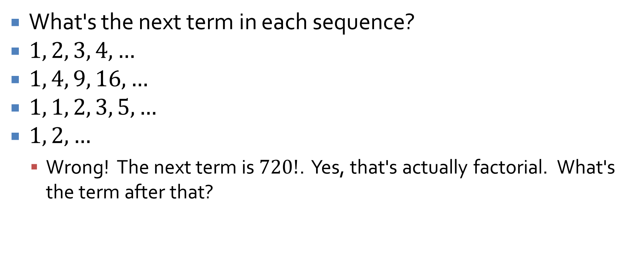
Examples
What's the next term in each sequence?
$1, 2, 3, 4, …$
$1, 4, 9, 16, …$
$1, 1, 2, 3, 5, …$
$1, 2, …$
Wrong! The next term is $720!$. Yes, that's actually factorial. What's the term after that?

Slide 9
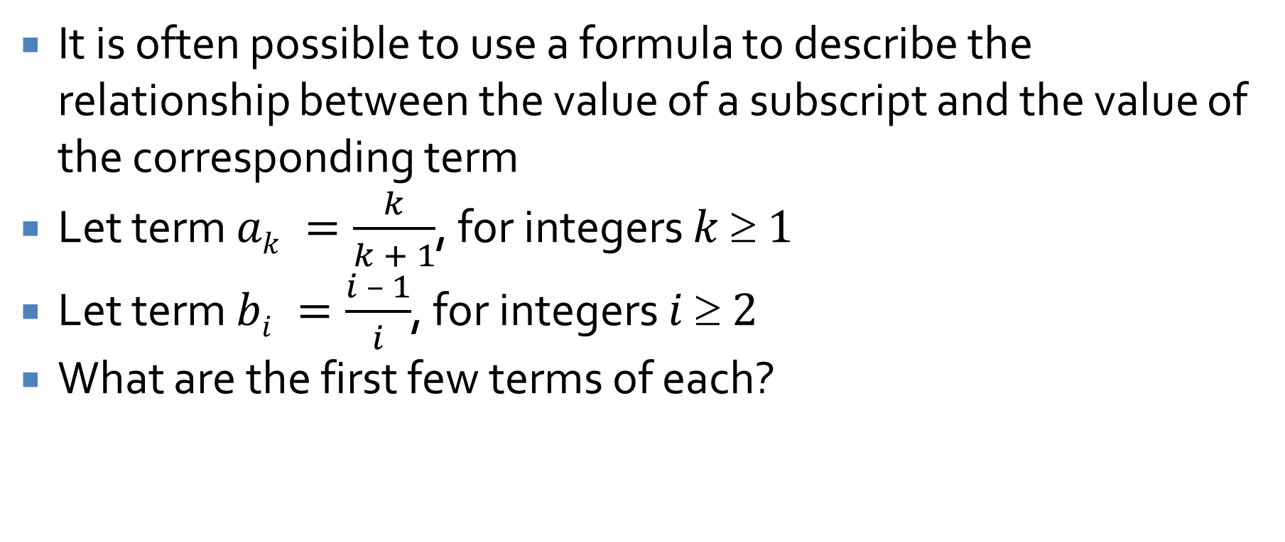
Explicit formulas
It is often possible to use a formula to describe the relationship between the value of a subscript and the value of the corresponding term
Let term $ak =\frac{k}{k + 1}$, for integers $k  1$
Let term $bi =\frac{i – 1}{i}$, for integers $i  2$
What are the first few terms of each?

Slide 10

Alternating sequences
It's important to note that not all sequences are monotonic
Give an explicit formula for $1, −3, 5, −7, 9, …$

Slide 11
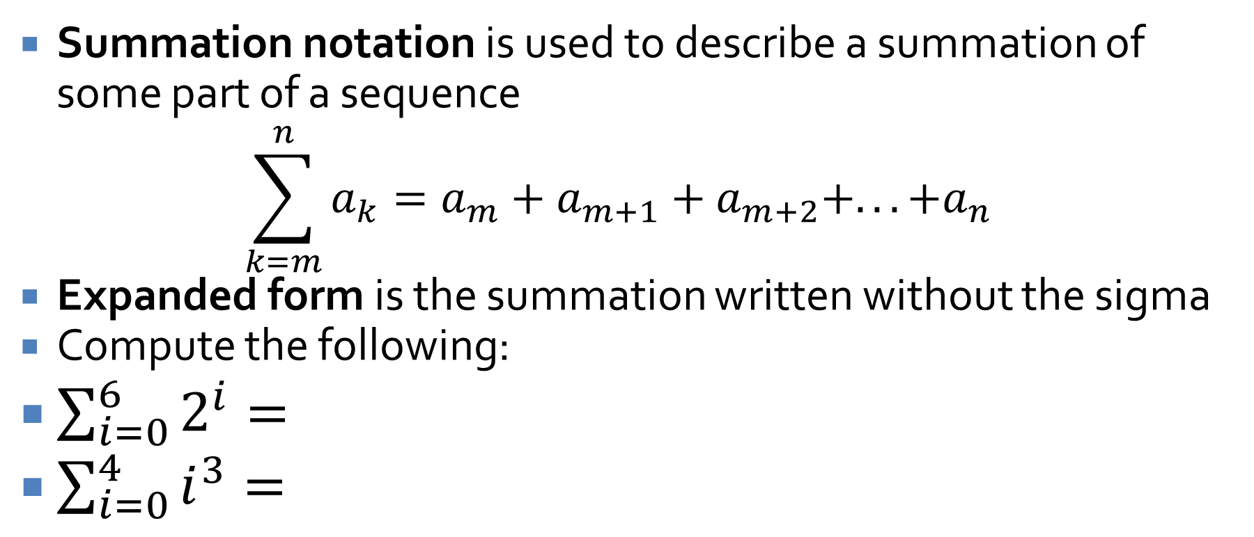
Summation notation
Summation notation is used to describe a summation of some part of a sequence
$$\sum_{k=m}^{n}{a_{k}}=a_{m}+a_{m+1}+a_{m+2}+...+a_{n}$$
Expanded form is the summation written without the sigma
Compute the following:
$\sum_{i=0}^{6}{2^{i}}=$
$\sum_{i=0}^{4}{i^{3}}=$

Slide 12

Convert to summation notation
$$\frac{1}{n}+\frac{2}{n+1}+\frac{3}{n+2}+ … +\frac{n+1}{2n}$$
$$\frac{1}{2}+\frac{1}{2∙3}+\frac{1}{3∙4}+ … +\frac{1}{n∙\left(n+1\right)}$$

Slide 13
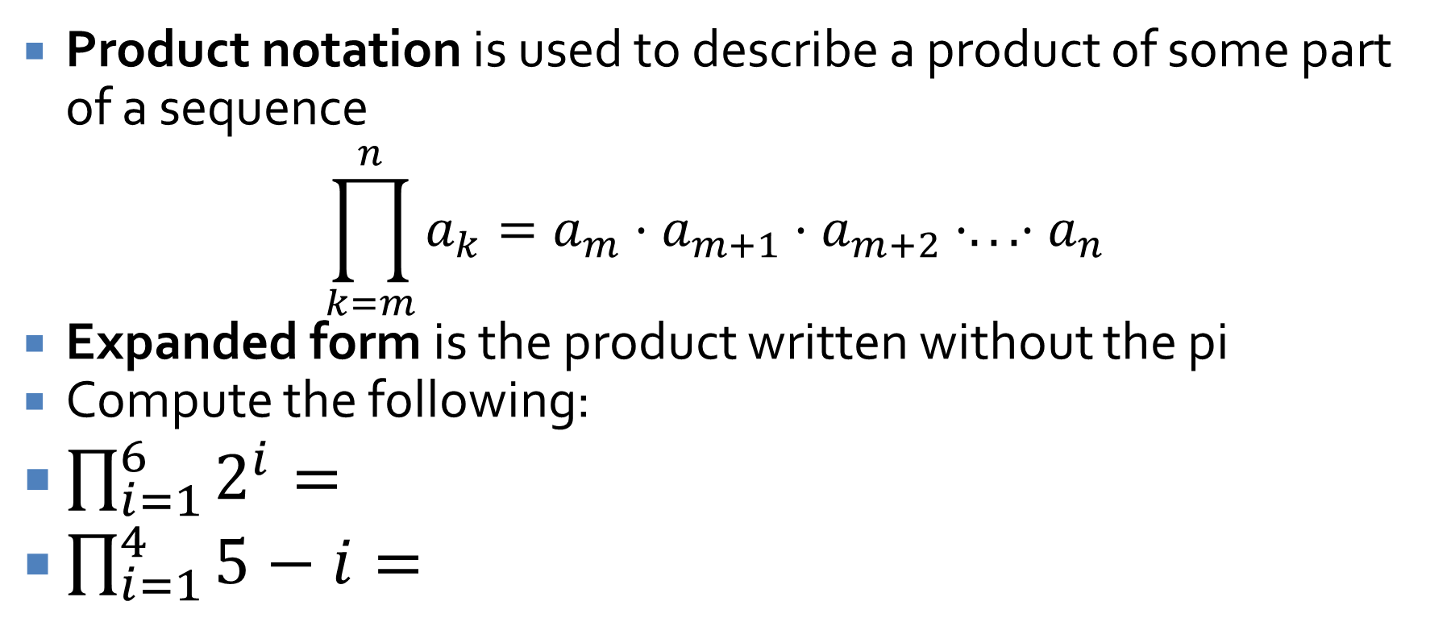
Product notation
Product notation is used to describe a product of some part of a sequence
$$\prod_{k=m}^{n}{a_{k}}=a_{m}⋅a_{m+1}⋅a_{m+2}⋅...⋅a_{n}$$
Expanded form is the product written without the pi
Compute the following:
$\prod_{i=1}^{6}{2^{i}}=$
$\prod_{i=1}^{4}{5−i}=$

Slide 14
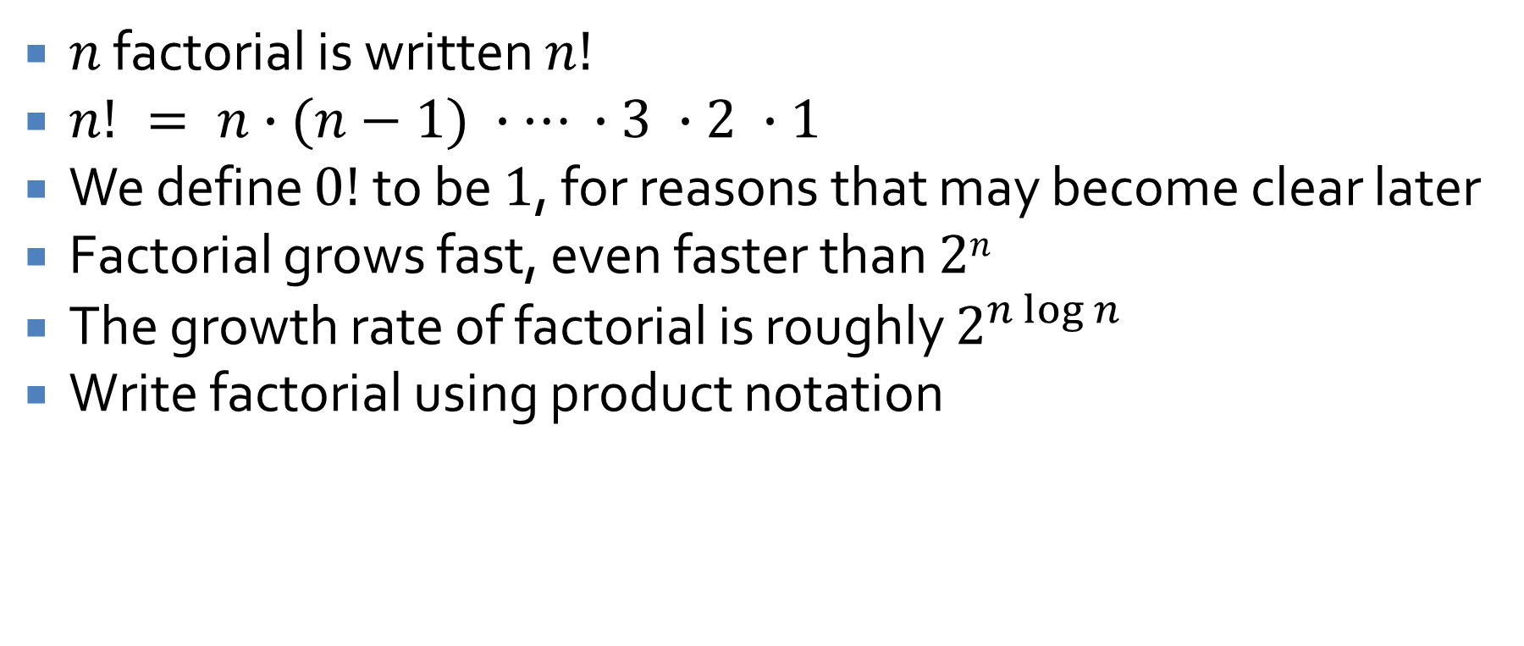
Factorial
$n$ factorial is written $n!$
$n! = n∙(n−1) ∙… ∙3 ∙2 ∙1$
We define $0!$ to be $1$, for reasons that may become clear later
Factorial grows fast, even faster than $2n$
The growth rate of factorial is roughly $2^{n\log{n}}$
Write factorial using product notation

Slide 15
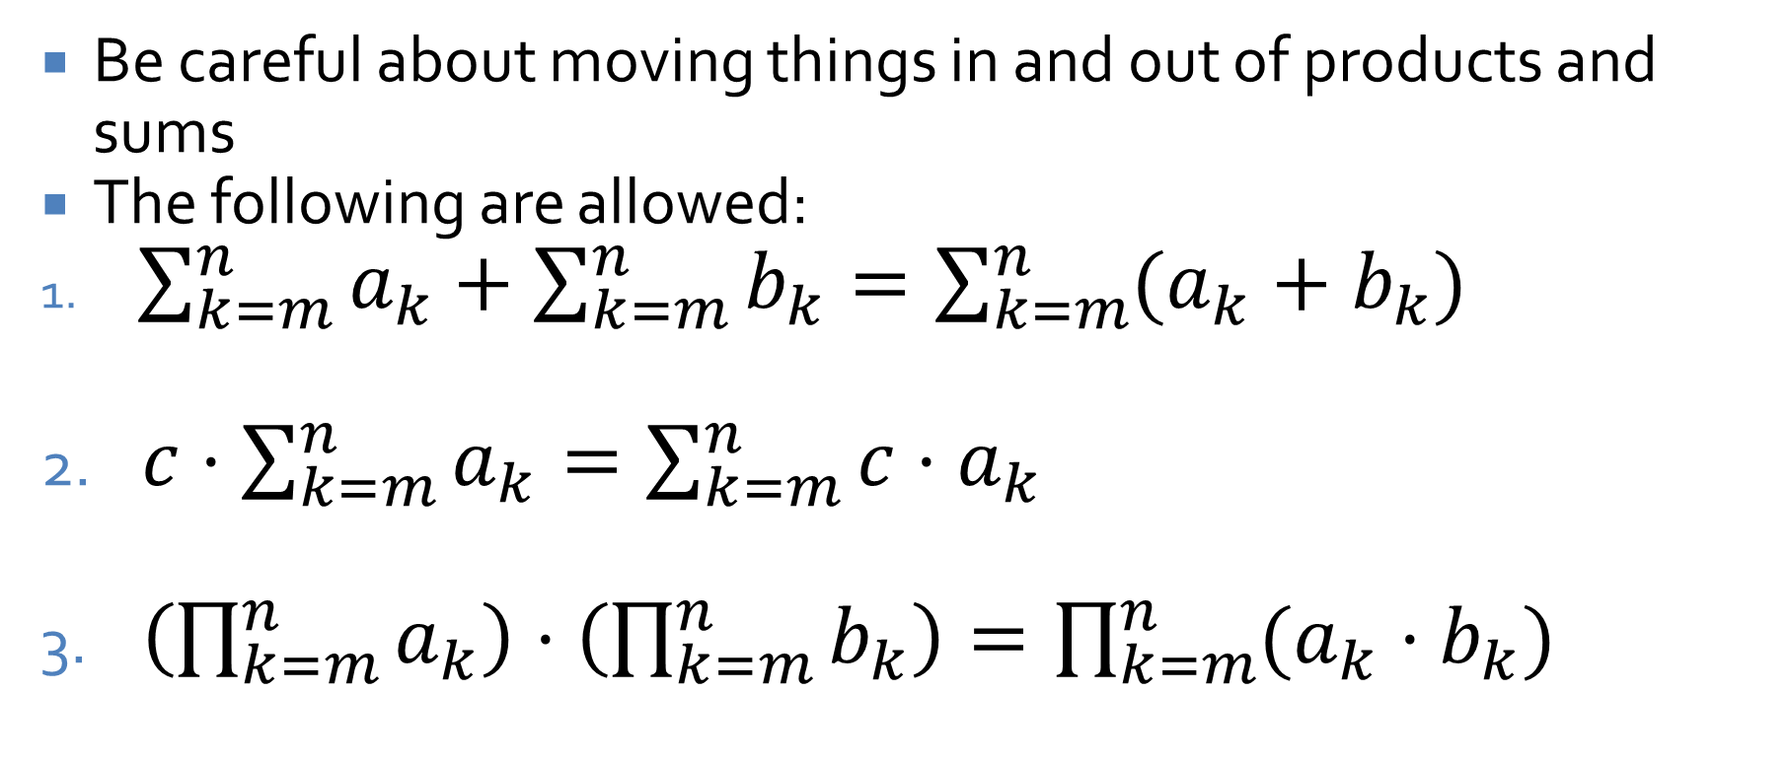
Properties of sums and products
Be careful about moving things in and out of products and sums
The following are allowed:
$\sum_{k=m}^{n}{a_{k}}+\sum_{k=m}^{n}{b_{k}}=\sum_{k=m}^{n}{(a_{k}+b_{k})}$
$c⋅\sum_{k=m}^{n}{a_{k}}=\sum_{k=m}^{n}{c⋅a_{k}}$
$\left(\prod_{k=m}^{n}{a_{k}}\right)⋅\left(\prod_{k=m}^{n}{b_{k}}\right)=\prod_{k=m}^{n}{(a_{k}}⋅b_{k})$

Slide 16
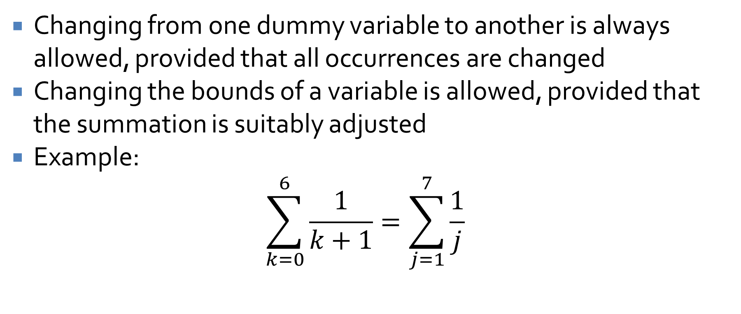
Changing variables
Changing from one dummy variable to another is always allowed, provided that all occurrences are changed
Changing the bounds of a variable is allowed, provided that the summation is suitably adjusted
Example:
$$\sum_{k=0}^{6}{\frac{1}{k+1}}=\sum_{j=1}^{7}{\frac{1}{j}}$$

Slide 17
Mathematical Induction

Slide 18
Induction
General induction is moving from a specific set of facts to a general conclusion
Example:
There are no tigers here.
I have a rock in my pocket.
Conclusion: My rock keeps tigers away.
Induction can lead you to invalid conclusions
So far in this class, we have only used deduction, which reasons from general truths to a specific conclusion

Slide 19

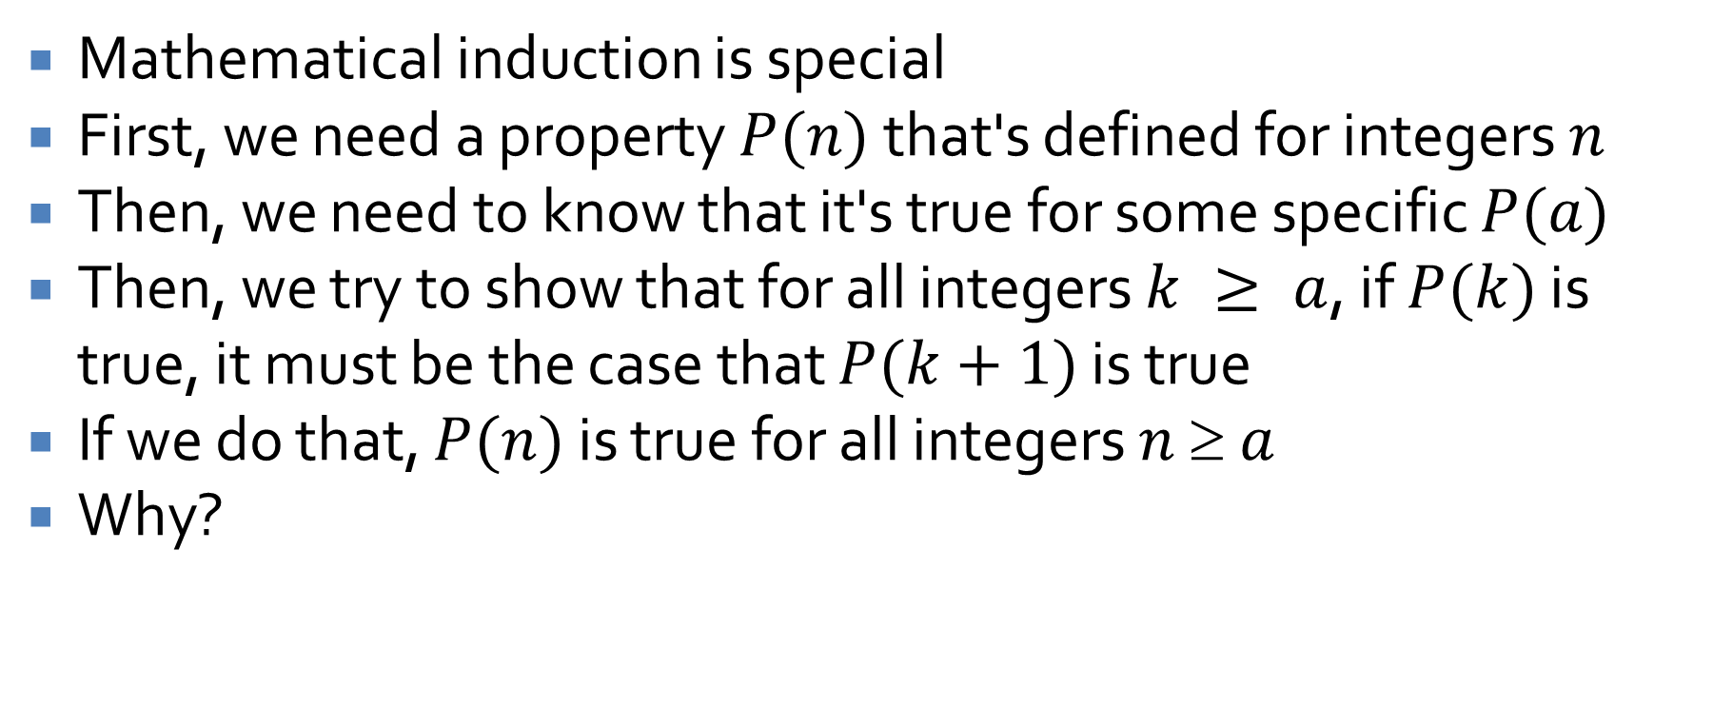
Mathematical induction
Mathematical induction is special
First, we need a property $P(n)$ that's defined for integers $n$
Then, we need to know that it's true for some specific $P(a)$
Then, we try to show that for all integers $k ≥ a$, if $P(k)$ is true, it must be the case that $P(k+1)$ is true
If we do that, $P(n)$ is true for all integers $n  a$
Why?

Slide 20
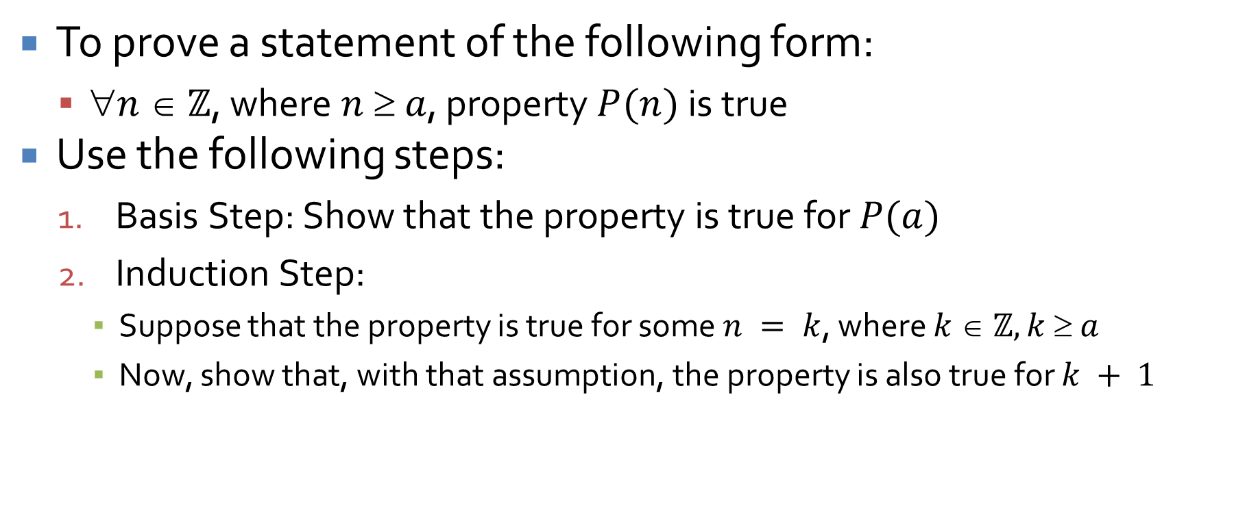
Proof by mathematical induction
To prove a statement of the following form:
$n  ℤ$, where $n  a$, property $P(n)$ is true
Use the following steps:
Basis Step: Show that the property is true for $P(a)$
Induction Step:
Suppose that the property is true for some $n = k$, where $k  ℤ, k  a$
Now, show that, with that assumption, the property is also true for $k + 1$

Slide 21

Example
Prove that, for all integers $n  1$
$$\sum_{i=1}^{n}{i}=\frac{n(n+1)}{2}$$
Hint: Use induction

Slide 22

Example
Prove that, for all integers $n  0$
$$\sum_{i=0}^{n}{2^{i}}=2^{n+1}−1$$
Hint: Use induction

Slide 23
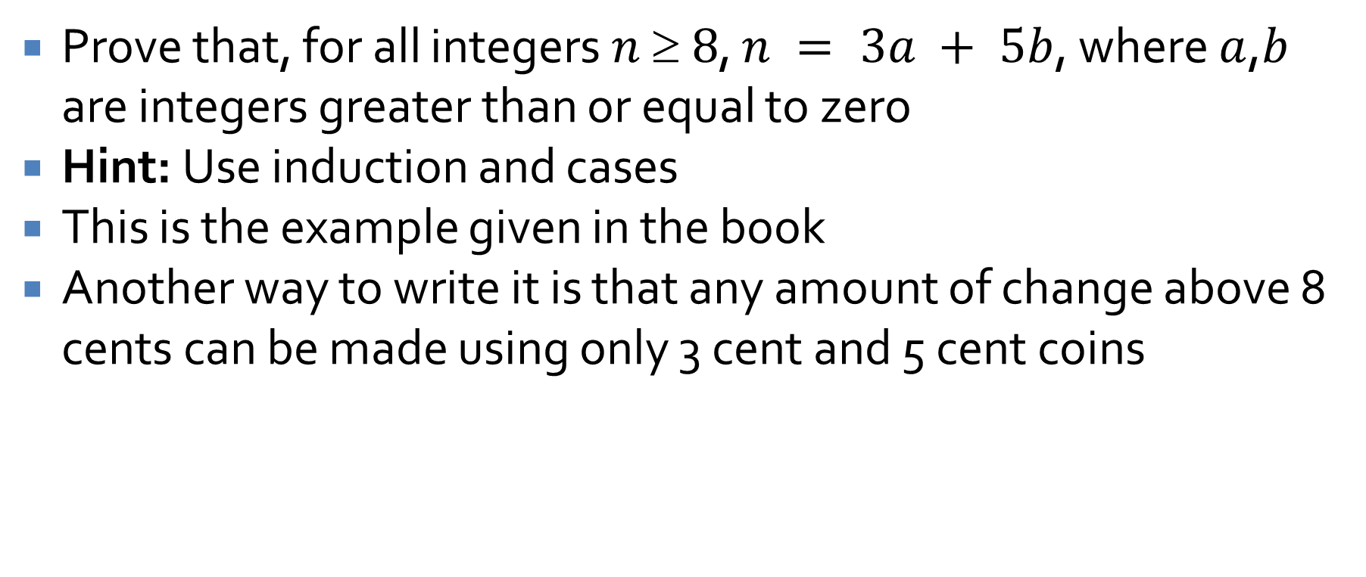
Example
Prove that, for all integers $n  8$, $n = 3a + 5b$, where $a$,$b$ are integers greater than or equal to zero
Hint: Use induction and cases
This is the example given in the book
Another way to write it is that any amount of change above 8 cents can be made using only 3 cent and 5 cent coins

Slide 24
Upcoming

Slide 25
Next time…
Geometric series
Strong induction
Examples

Slide 26
Reminders
Keep working on Assignment 2
Read 5.2, 5.3, and 5.4

